Slide 1
Ansible Automation
Requirements & Architecture

Slide 2

What is Ansible?
Ansible is a suite of software tools that enables infrastructure as code. It is an open-source suite that includes software provisioning, configuration management, and application deployment functionality.

Slide 3
What is needed to run Ansible?
Control node – machine Ansible is installed and configured on.
Python – Python is a high-level, general-purpose programming language. Its design philosophy emphasizes code readability with the use of significant indentation.
PIP – Python package installer.
PIPENV - A tool that provides all necessary means to create a virtual environment for your Python project.
Ansible – is an open-source suite that includes software provisioning, configuration management, and application deployment functionality.
Ansible-Lint - a YAML linter specific to Ansible playbooks. That means when you lint a playbook, it's not just looking at the markup syntax but also how you're using Ansible modules.
Ansible Collections - Ansible Content Collections are a distribution format for Red Hat® Ansible® Automation Platform content that can include playbooks, roles, modules, and plugins around specific topic areas.
Ansible target host - machine that Ansible 'Playbooks' are run against.

Slide 4
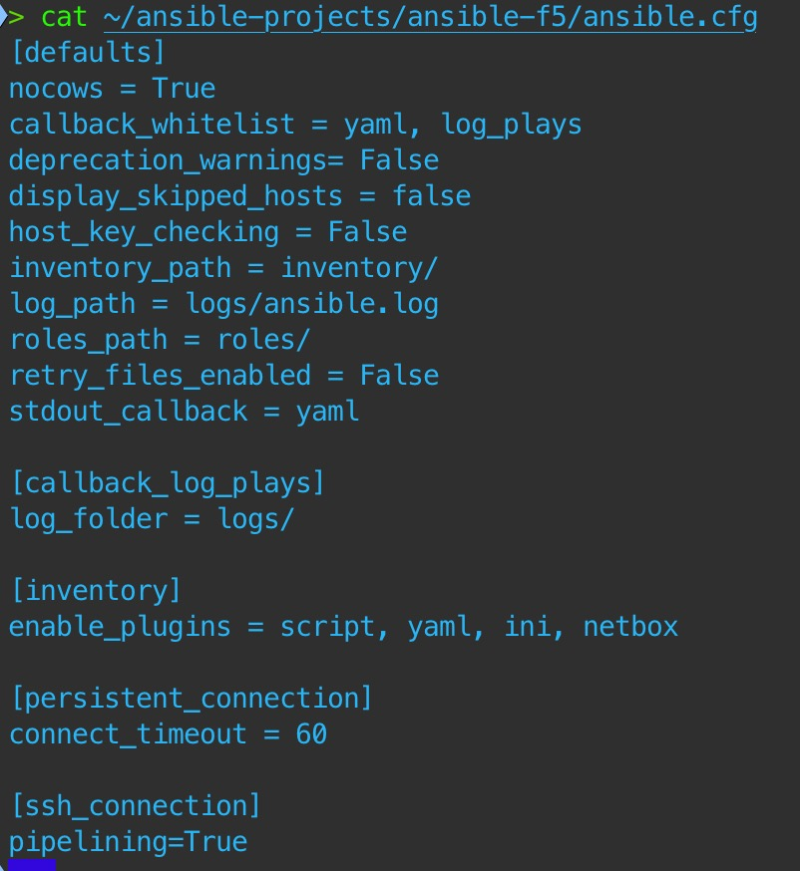
Ansible Configuration file
What is it? How to set it up.
This is the brain and the heart of Ansible, the file that governs the behavior of all interactions performed by the control node. In Ansible's case that default configuration file is (ansible.cfg)

Slide 5
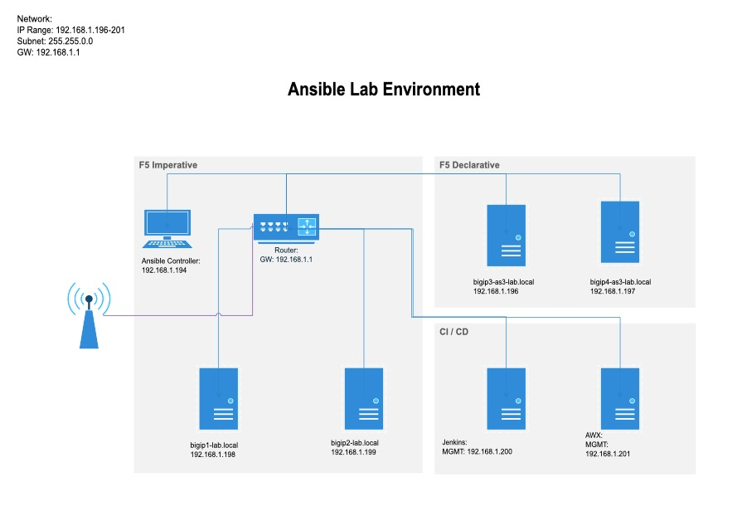
Ansible Lab Environment
Local lab

Slide 6
Useful resources
Links to documentation
Ansible documentation:
https://docs.ansible.com
Ansible FAQ:
https://docs.ansible.com/ansible/latest/reference_appendices/faq.html
F5 Ansible documentation:
https://clouddocs.f5.com/products/orchestration/ansible/devel/
Python documentation:
https://www.python.org

